Slide 1
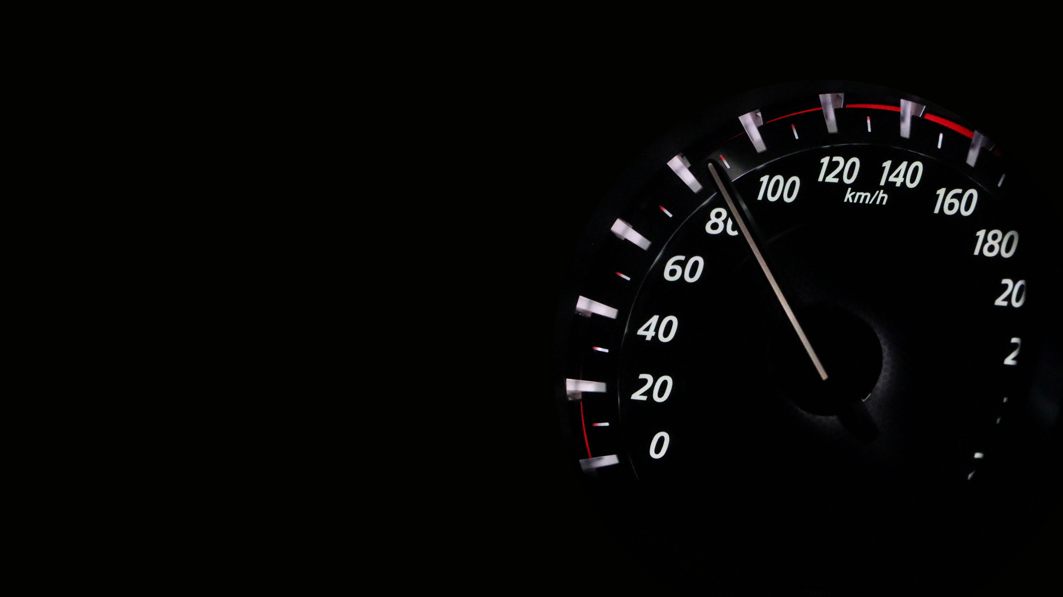
Road
Accident
Analysis
-Yeshwant Jadhav

Slide 2


AIM
To Analyze the road accidents
and create a dynamic dashboard

Slide 3

Primary KPIs
Fatal Casualties
Serious Casualties
Slight Casualties
Car Casualties

Slide 4


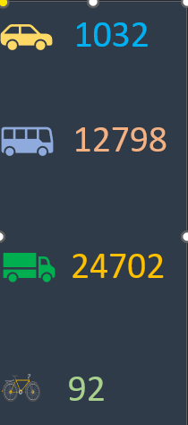


Secondary
KPIs

Slide 5




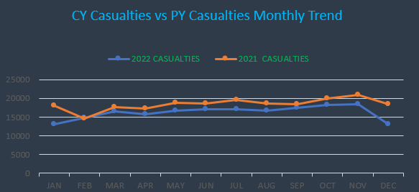

Monthly Trend

Slide 6


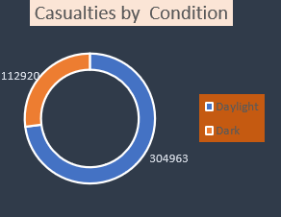
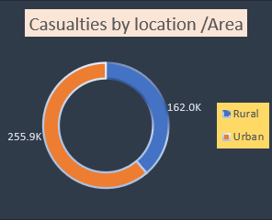
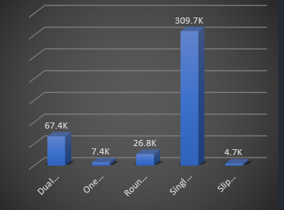
Other Charts

Slide 7
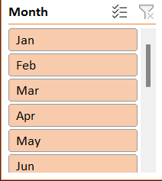



Slicers

Slide 8
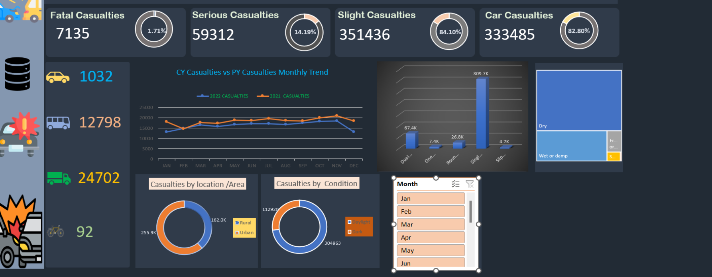

Slide 9


